Slide 1

NLP | Automated Customer Reviews
Hessa-Shatha-Ghadah

Slide 2

overview of the project:
Data reprossesing
Larger Data
Sentiment Classification
clustring
Web App Deployment

Slide 3
PROJECT GOALS
Classify customer reviews as positive, negative, or neutral.
Cluster reviews into product categories
Generate blog-style summaries using Generative AI.
Deploy the system as a user-friendly web app

Slide 4
Data explore & Preprocessing

Slide 5
primary Data Processing:
importing primary data sets from kaggle
Keep Only Relevant Columns in Each Dataset
Map star ratings to sentiment classes
Combine the three datasets into one
exploratory data analysis (EDA)
split the
data
split the
data
balance the
data

Slide 6
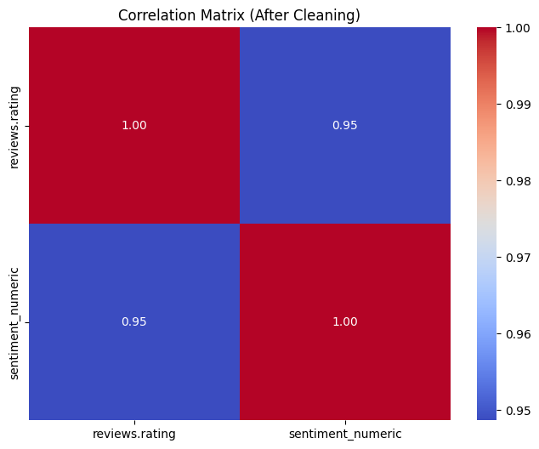
Correlation Matrix :

Slide 7
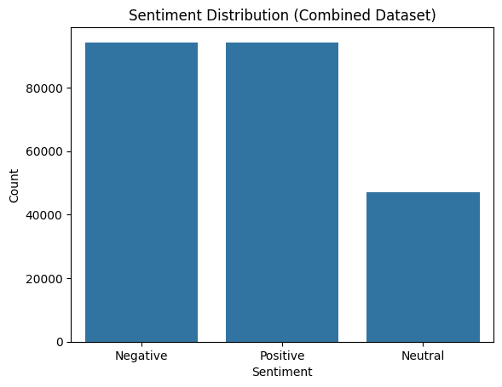
explore sentiment:

Slide 8
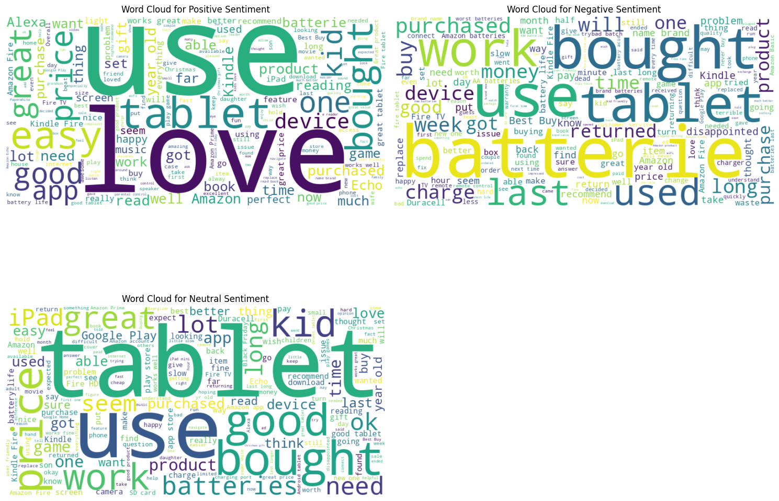
word cloud(positive):

Slide 9
word cloud(negative):

Slide 10
word cloud(neutral):

Slide 11
Larger Data

Slide 12
primary Data Processing:
Combine the primary dataset with the large dataset
Create a Balanced Sentiment Dataset
Clean Sentiment Column and Prepare for Modeling
Undersample Reviews to Balance Ratings
importing large data set from HF
split the
data
review the Balanced Dataset

Slide 13
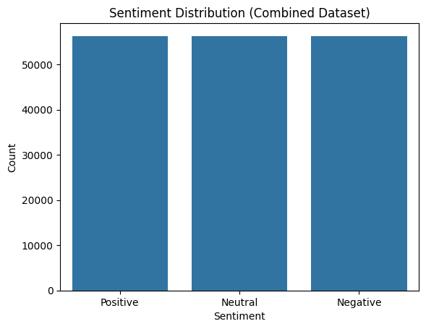
explore sentiment:

Slide 14
Sentiment Classification :

Slide 15
Sentiment Classification: Model Comparison
This section presents a comparative analysis between two transformer-based models used for sentiment classification on Amazon product reviews:
Model A: DistilRoBERTa (uses the larger Amazon Reviews Dataset)
Model B: distilroberta-base (uses the Primary Dataset: Amazon Product Reviews)
-The comparison focuses on each model’s efficiency and accuracy, based on the size and diversity of the dataset.

Slide 16
Model A: DistilRoBERTa
DistilRoBERTa is a smaller and faster update of the RoBERTa model. It still gives good results. It was trained on a big Amazon reviews dataset, which includes many product types and a lot of labeled reviews.
Because it saw more different examples during training, this model can understand new or unbalanced data better. It is expected to work well even with data it has not seen before.

Slide 17
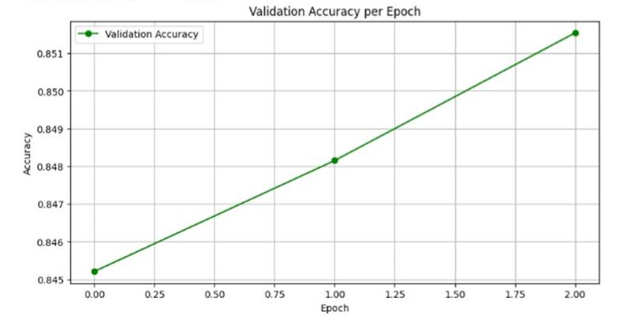
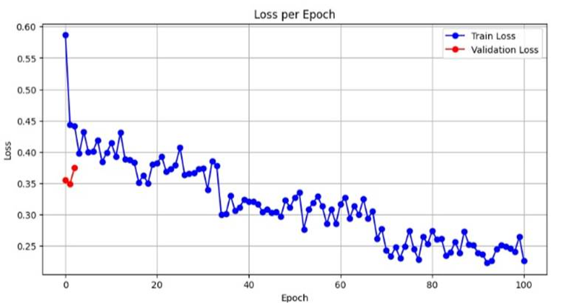
Model A: DistilRoBERTa
-Performance:

Slide 18
Model B: distilroberta-base
This model was trained on a smaller Amazon reviews dataset. It has three main files with customer reviews. Even though it’s smaller, the data is more focused and well-organized. This helps the model learn better from clear and good-quality data.
This model is good for tasks where we want to understand feelings (sentiment) in a specific topic, not general ones.

Slide 19
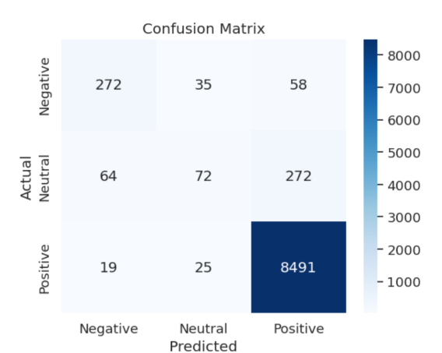
Model A: distilroberta Confusion
Matrix:

Slide 20
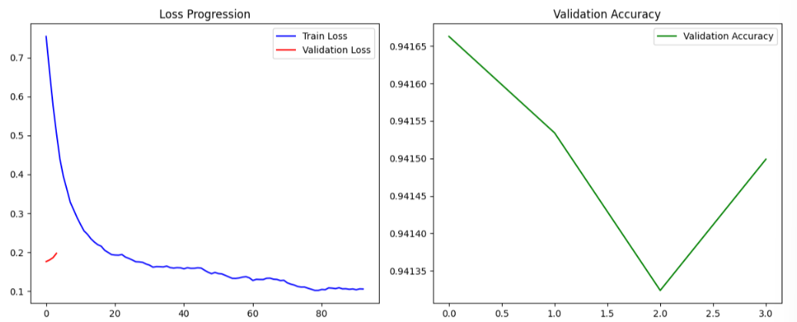
Model B: distilroberta-base-Performance:

Slide 21
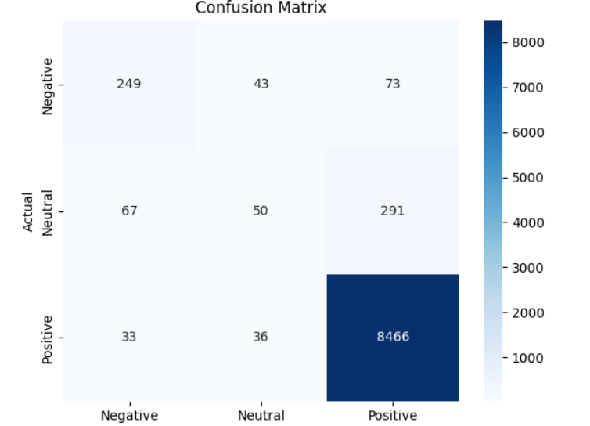
Model B: distilroberta-base Confusion
Matrix:

Slide 22
Model Comparison Table:
Metric | Model A: DistilRoBERTa uses the larger Dataset | Model B: distilroberta-base uses the Primary Dataset
Accuracy | 85.15% | 94%
Precision | Negative 81% Neutral 65% Positive 98% | Negative 71% Neutral 39% Positive 96%
Recall | Negative 85% Neutral 58% Positive 99% | Negative 68% Neutral 12% Positive 99%
F1-Score | Negative 83% Neutral 61% Positive 98% | Negative 70% Neutral 19% Positive 98%
Training Time | Longer | Faster

Slide 23
CLUSTRING

Slide 24
clustring
to simplify product categorization, we built a clustering model that groups detailed product types into 4–6 broader meta-categories. The process involved:
Data Cleaning & Preprocessing: Removed noise and extracted meaningful phrases using spaCy.
Embedding Generation: Used the MiniLM sentence transformer to convert text into numerical vectors.
Dimensionality Reduction: Applied UMAP to reduce embedding size for faster and more efficient clustering.
Clustering: Used K-Means, tested multiple cluster counts (4–6), and evaluated results using silhouette and Davies-Bouldin scores. A refinement step improved cluster quality.
Visualization & Analysis: Visualized clusters using t-SNE and extracted top keywords per cluster while ignoring generic terms.
This model effectively groups products by semantic similarity, supporting better search, recommendations, and category management.

Slide 25
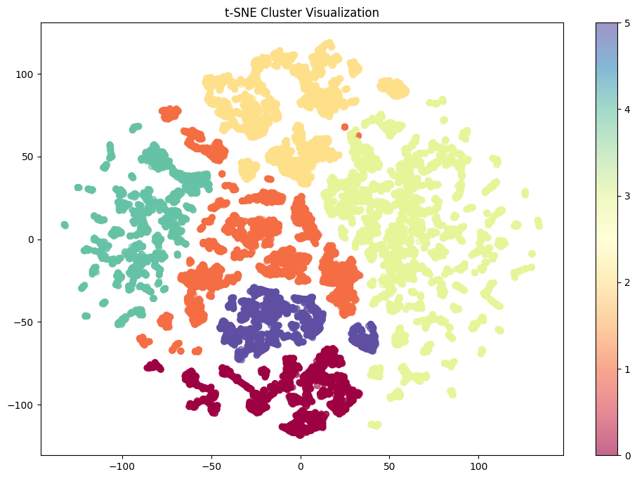

Slide 26
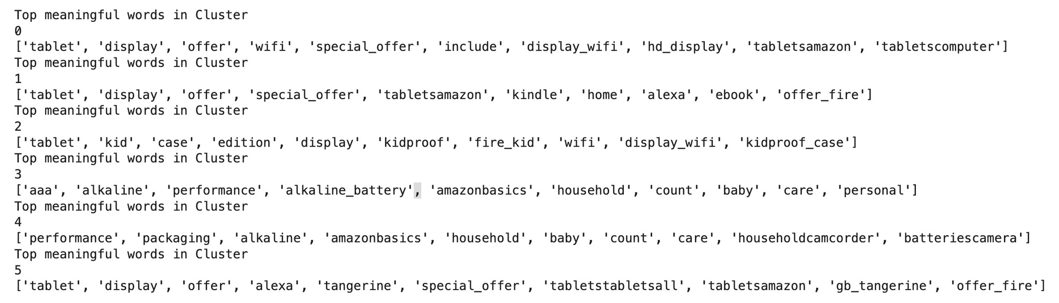
clustring

Slide 27
Summarization Model:

Slide 28



:Summarization Model:
Grouped by product
Extracted: category, reviews, ratings
Filtered out products with <5 reviews
Identified top pros/complaints
Calculated average rating
Picked top 3 best-rated products & 1 worst-rated
Summarized each with name, rating, pros, and complaints
Final Output
GPT-4 created ready-to-publish articles
Useful for blogs, guides, or product recommendation
.
Data Structuring
Insights
Setup & Data Import
4. GPT-4 Prompt Engineering
. GPT-4 Prompt Engineering
Installed OpenAI API + libraries
Loaded product reviews with categories & cluster labels
Designed blog-style prompt
Intro + product highlights (top 3 & 1 to avoid)
Wrapped with a clean conclusion
Designed blog-style prompt
Intro + product highlights (top 3 & 1 to avoid)
Wrapped with a clean conclusion

Slide 29
DEPLOYMENT :

Slide 30
deployment :
Deployment
🧩 Environment
Python 3.10 with virtual environment
Key libs: transformers, sentence-transformers, scikit-learn, pandas, torch, gradio, openai, nltk
💻 Local Setup
Deployed with Gradio
Run via: python app.py
UI includes:
Classification tab
Clustering tab
GPT-4 summarizer tab
🌐 API & Files
OpenAI GPT-4 via secure API key
Supports .csv and .parquet file uploads

Slide 31
THANK YOU !

